Slide 1
Wireless Networks and Protocols LAN MAC Protocols
Wireless versus Wired
1

Slide 2
Outline
Data link fundamentals
» And what changes in wireless
Aloha
Ethernet
Wireless-specific challenges
802.11 and 802.15 wireless standards
2

Slide 3
Datalink Functions
Framing: encapsulating a packet into a bit stream.
» Add header, mark and detect frame boundaries, …
Logical link control: managing the transfer between the sender and receiver, e.g.
» Error detection and correction to deal with bit errors
» Flow control: avoid that the sender outruns the receiver
Media access: controlling which device gets to send a frame next over a link
» Easy for point-to-point links; half versus full duplex
» Harder for multi-access links: who gets to send?
3

Slide 4

Framing
Typical structure of a “wired” packet:
» Preamble: synchronize clocks sender and receiver
» Header: addresses, type field, length, etc.
» The data to be send, e.g., an IP packet
» Trailer: padding, CRC, ..
/Length
How does wireless differ?
» Different transmit rates for different parts of packet
» Explicit multi-hop support
» Control information for physical layer
» Ensure robustness of the header
4

Slide 5
Error Control: Error Detection and Error Recovery
Detection: only detect errors
» Make sure corrupted packets get thrown away, e.g.
Ethernet
» Use of error detection codes, e.g., CRC
Recovery: also try to recover from lost or corrupted packets
» Option 1: forward error correction (redundancy)
» Option 2: retransmissions
How does wireless differ?
» Uses CRC to detect errors, similar to wired
» Error recovery is much more important because errors are more common and error behavior is very dynamic
» What approach is used?
5

Slide 6
Error Recovery in Wireless
Use of redundancy:
» Very common at physical layer – see PHY lectures
Use of Automatic Repeat Request (ARQ)
» Use time outs to detect loss and retransmit
Many variants:
» Stop and wait: one packet at a time
The most common at the datalink
» Sliding window: receiver tells sender how much to send
Many retransmission strategies: go-back-N, selective repeat, …
When should what variant be used?
» Noise versus bursty (strong) interference
6

Slide 7
Stop and Wait
Simplest ARQ protocol
Send a packet, stop and wait until acknowledgement arrives
Will examine ARQ issues later in semester
Limitations?
What popular for the datalink?
Sender
Receiver
Time
Timeout
7

Slide 8
Media Access Control
How do we transfer packets between two hosts connected to the same network?
Using point-to-point “links” with “switches” -- store-and-forward
» Very common in wired networks, at multiple layers
Multiple access networks
» Multiple hosts are sharing the same transmission medium
» Need to control access to the medium
» Taking turn versus contention based protocols
What is different in wireless?
» Is store and forward used?
» Is multiple access used?
8

Slide 9
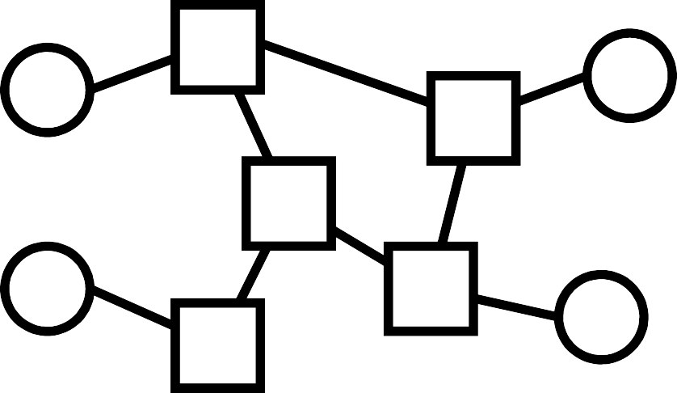
Datalink Architectures
Routing and packet forwarding.
Point-to-Point error and flow control.
Switched ethernet, mesh and ad hoc networks
Media access control.
Scalability.
Traditional ethernet, Wifi, Aloha, …
9

Slide 10
Multiple Access Networks
A B C D E
Who gets to send a packet next?
Scheduled access: explicit coordination ensures that only one node transmits
» Looks cleaner, more organized, but …
» Coordination introduces overhead – requires communication (oops)
Random access: no explicit coordination
» Potentially more efficient, but …
» How does a node decide whether it can transmit?
» Collisions are unavoidable – also results in overhead
» How do you even detect a collision?
10

Slide 11
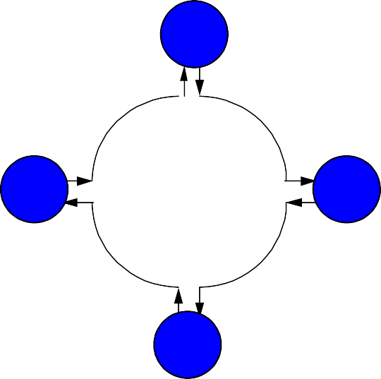
Scheduled Access MACs
Central Controller
Polling: controller polls each nodes
Reservation systems
» Central controller
» Distributed algorithm, e.g. using reservation bits in frame
Token ring: token travels around ring and allows nodes to send one packet
» Distributer version of polling
» FDDI, …
11
₄4
₂2
₃2
11
P
eter A. Steenkiste

Slide 12
Outline
Data link fundamentals
» And what changes in wireless
Aloha
Ethernet
Wireless-specific challenges
802.11 and 802.15 wireless standards

Slide 13
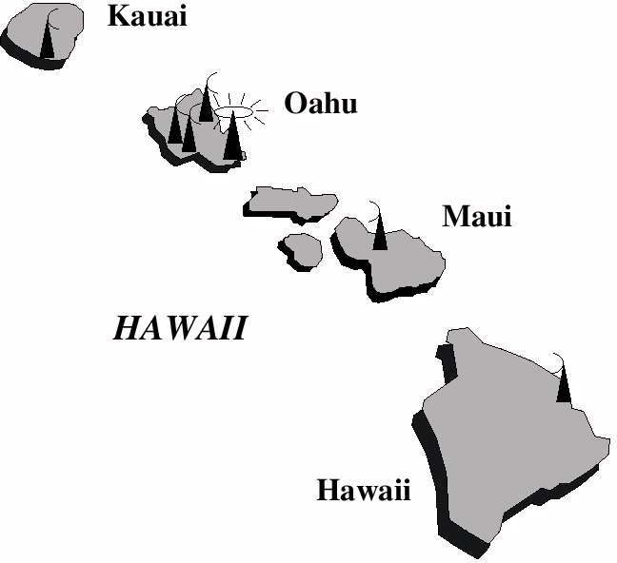
Why ALOHA

Slide 14
Pure ALOHA
Developed in University of Hawaii in early 1970’s.
It does not get much simpler:
A user transmits at will
If two or more messages overlap in time, there is a collision – receiver cannot decode packets
Receive waits for roundtrip time plus a fixed increment – lack of ACK = collision
After a collision, colliding stations retransmit the packet, but they stagger their attempts randomly to reduce the chance of repeat collisions
After several attempts, senders give up
Although very simple, it is wasteful of bandwidth, attaining an efficiency of at most 1/(2e) = 0.18

Slide 15
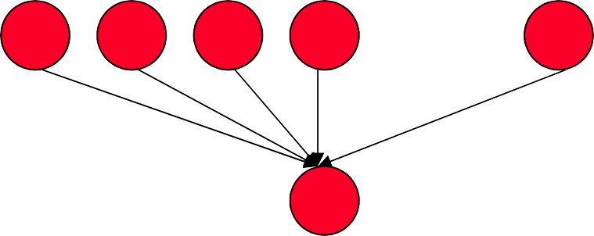
Pure ALOHA: Model
Let there be N stations contending for use of the channel.
Each station transmits λ packets/sec on average based on a Poisson arrival process
All messages transmitted are of the same fixed length, m, in units of time
Let new traffic intensity be S = Nλm
Since all new packets eventually get through, ‘S’ is also the network throughput
1 2 3 4
_{l} l
. . .
N
l
R
17
Peter A. Steenkiste

Slide 16
Pure Aloha: Vulnerability
Simplification: assume the retransmitted messages are independent random process as well
The total rate of packets attempting transmission = newly generated packets + retransmitted ones = λ’ > λ
The total traffic intensity (including retransmissions) is ,
G = N λ’m
The “vulnerable period” in which a collision can occur for a given packet is 2 x m sec

Slide 17
Pure Aloha: Analysis
Calculate the “Probability of no collision” two ways:
Probability that there is no arrival in interval 2 x m: P(no arrival in 2 x m sec) = e^{-2Nλ’m} = e^{-2G}
Since all new arrivals eventually get through, we have
λ / λ’ = S/G = Fraction of transmissions that are successful
So,
S/G = Probability of no collision
= P(no arrival in 2m sec)
Thus,
S/G = e^{-2G} S = Ge^{-2G}
Maximum Throughput of Pure Aloha

Slide 18
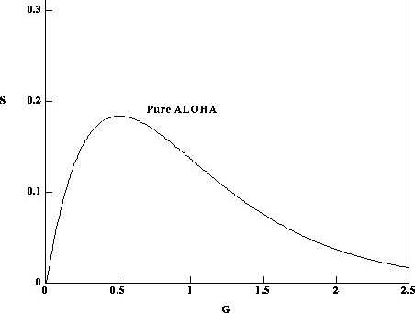
Analysis Conclusion
S is maximum at S = ¹
at G = 0.5
2e
1
2e
20
teenkiste
20
Peter A. S

Slide 19
Slotted ALOHA
Transmission can only start at the beginning of each slot of length T
Vulnerable period is reduced to T
» Instead of 2xT in Aloha
Doubles maximum throughput.
x
x+1
x+2
x+3

Slide 20
Slotted ALOHA Analysis
Key point: The ”vulnerable period” of the packet of size m has been reduced from 2m to only m !
Since Poisson arrivals,
P(successful transmission) = e^{-G}
Note: Not 2G
The throughput is then, S = Ge^{-G}
The throughput S has maximum value of 1/e =
0.368 at G = 1.

Slide 21
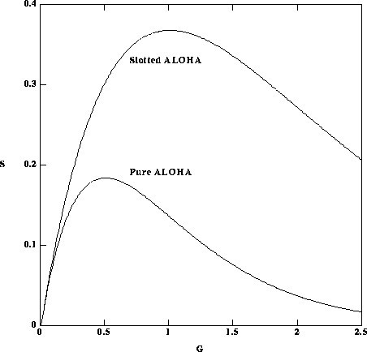
Analysis Results Slotted ALOHA
1
e
1
2e
. Steenkiste ²³ 2
3
Peter A

Slide 22
Discussion of ALOHA
Maximum throughput of ALOHA is very low 1/(2e) = 18%, but
» Has very low latency under light load
Slotted Alohas has twice the performance of basic Aloha, but performance is still poor
» Slightly longer delay than pure Aloha
» Inefficient for variable sized packets!
» Must synchronize nodes
Still, not bad for an absolutely minimal protocol!
» Good solution if load is low – used in some sensor networking technologies (cheap, simple)
How do we go faster?

Slide 23
Outline
Data link fundamentals
» And what changes in wireless
Aloha
Ethernet
Wireless-specific challenges
802.11 and 802.15 wireless standards

Slide 24
“Regular” Ethernet CSMA/CD
Multiple Access: multiple hosts are competing for access to the channel
Carrier-Sense: make sure the channel is idle before sending – “listen before you send”
Collision Detection: collisions are detected by listening on the medium and comparing the received and transmitted signals
Collisions results in 1) aborting the colliding transmissions and 2) retransmission of the packets
Exponential backoff is used to reduce the chance of repeat collisions
» Also effectively reduces congestion

Slide 25
Carrier Sense Multiple Access/ Collision Detection (CSMA/CD)
Packet?
No
Sense Carrier
Send
Detect Collision
Discard Packet
Yes
Jam channel b=CalcBackoff()
; wait(b); attempts++;
attempts < 16
attempts == 16

Slide 26
Ethernet Backoff Calculation
Challenge: how do we avoid that two nodes retransmit at the same time collision
Exponentially increasing random delay
» Infer “number” senders from # of collisions
» More senders → increase wait time
First collision: choose K from {0,1}; delay is K x 512 bit transmission times
After second collision: choose K from
{0,1,2,3}
After ten or more collisions, choose K from
{0,1,2,3,4,…,1023}

Slide 27
How to Handle Transmission When Line is Sensed Busy
p-persistent scheme:
» Transmit with probability p once the channel goes idle
» Delay the transmission by t_{prop} with the probability (1-p)
1-persistent scheme: p = 1
» E.g. Ethernet
nonpersistent scheme:
» Reschedule transmission for a later time based on a retransmission delay distribution (e.g. exp backoff)
» Senses the channel at that time
» Repeat the process
When is each solution most appropriate?

Slide 28
Dealing with Collisions

Slide 29
So What about Wireless?
Depends on many factors, but high level:
Random access solutions are a good fit for data in the unlicensed spectrum
» Lower control complexity, especially for contention-based protocols (e.g., Ethernet)
» There may not always be a centralized controller
» May need to support multi-hop
» Also used in many unlicensed bands
Cellular uses scheduled access
» Need to be able to guarantee performance
» Have control over spectrum – simplifies scheduled access

Slide 30
Code Division Multiple Access
Users use a spectrum band at the same time, but they use different codes to spread their data over the frequency
» Spread spectrum with users use different spreading sequences
» Spreading sequences that are orthogonal, i.e., they have minimal overlap
» Base station manages spreading codes
The signal of other users will appear as noise
» But the transmissions are very robust because of the use of spread spectrum
Offers an easy way to share spectrum
» Adding users will increase the noise for each user
» This will reduce their throughput – sharing!
13

Slide 31
CDMA Principle

Slide 32
CDMA Example
User A code = <1, –1, –1, 1, –1, 1>
» To send a 1 bit = <1, –1, –1, 1, –1, 1>
» To send a 0 bit = <–1, 1, 1, –1, 1, –1>
User B code = <1, 1, –1, – 1, 1, 1>
» To send a 1 bit = <1, 1, –1, –1, 1, 1>
Receiver receiving with A’s code
» (A’s code) x (received chip pattern)
User A ‘1’ bit: 6 -> 1
– User A ‘0’ bit: -6 -> 0
User B ‘1’ bit: 0 -> unwanted signal ignored

Slide 33
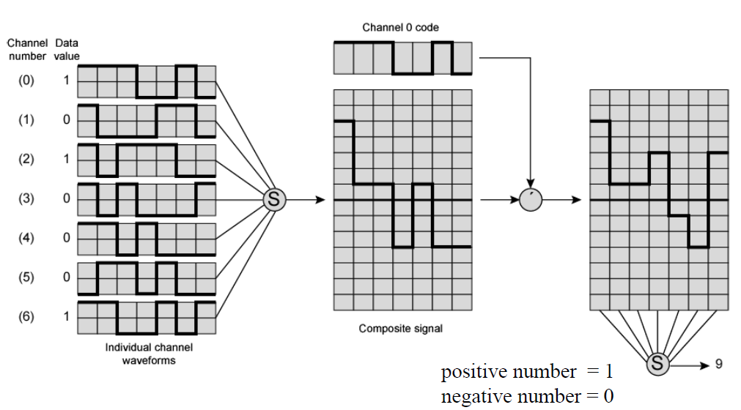
Example
P

Slide 34
CDMA Discussion
CDMA does not assign a fixed bandwidth, but a user’s bandwidth depends on the traffic load
» More users results in more “noise” and less throughput for each user, e.g., more information lost due to errors
» How graceful the degradation is depends on how orthogonal the codes are
» TDMA and FDMA have a fixed channel capacity
Weaker signals may be lost in the clutter
» This will systematically put the same node pairs at a disadvantage – not acceptable
» The solution is to add power control, i.e. nearby nodes use a lower transmission power than remote nodes
34

Slide 35
CDMA Example
CDMA cellular standard
» 3G standard
» Used in the US, e.g. Sprint
Allocates 1.228 MHz for base station to mobile communication
» Shared by 64 “code channels”
» Used for voice (55), paging service (8), and control (1)
Provides a lot error coding to recover from errors
» Voice data is 8550 bps
» Coding and FEC increase this to 19.2 kbps
» Then spread out over 1.228 MHz using DSSS; uses QPSK
35

Slide 36
Summary
Spread spectrum achieves robustness by spreading out the signal over a wide channel
» Sending different data blocks on different frequencies, or
» Spreading all data across the entire channel
CDMA builds on the same concept by allowing multiple senders to simultaneously use the same channel
» Sender and receive must coordinate so receiver can decode the data
36

Slide 37
How Do We Increase Rates?
Two challenges related to multipath:
Frequency selective fading starts to have a bigger impact because there is less redundancy in the signal
» This is major issue for wide-band channels only
As rates increase, symbol times shrink and the effects of inter-symbol interference becomes more pronounced
» There is a limit on how much we can shrink symbol times
We need an encoding/modulation solution that has long symbol times and limits the impact of frequency selective fading

Slide 38

Inter-Symbol-Interference
Transmitted signal:
Received Signals:
Line-of-sight:
Reflected:
The symbols add up on the channel
→ Distortion!
Delays
38

Slide 39
OFDM - Orthogonal Frequency Division Multiplexing

Slide 40
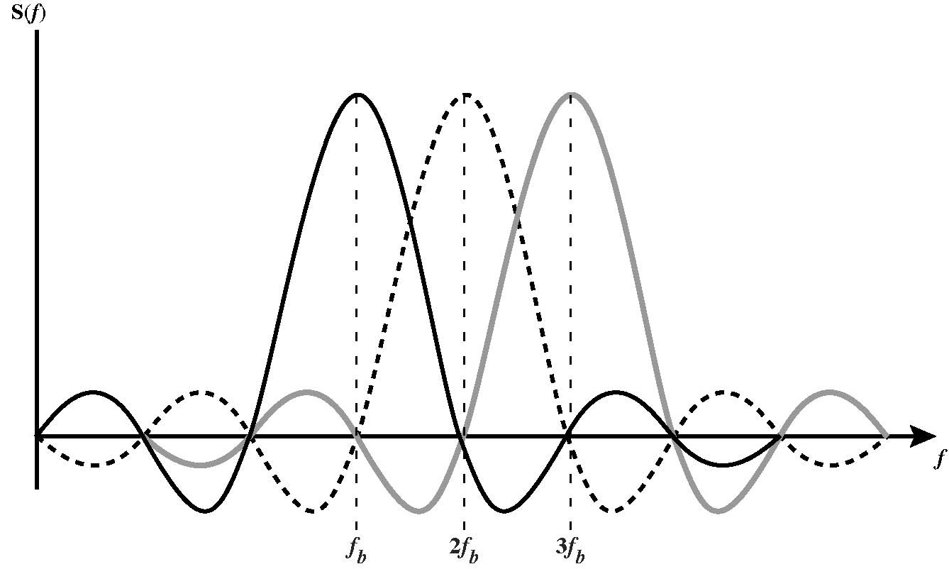
Subcarriers are “Orthogonal”
Peaks of spectral density of each carrier coincide with the zeros of the other carriers
» Carriers can be packed very densely with minimal interference
» Requires very good control over frequencies

Slide 41
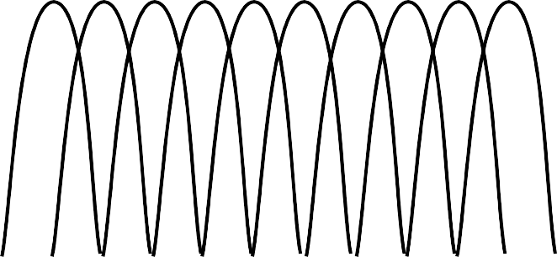
Densely Packing OFDM Channels
Ch.1
Ch.2
Ch.3
Ch.4
Ch.5
Ch.6
Ch.7
Ch.8
Ch.9
Ch.10
Conventional multicarrier techniques
frequency
Ch.2 Ch.4 Ch.6 Ch.8 Ch.10 Ch.1 Ch.3 Ch.5 Ch.7 Ch.9
Saving of bandwidth
50% bandwidth saving
Orthogonal multicarrier techniques
frequency

Slide 42
Advantages of OFDM

